Slide 1
A gentle introduction to procedural macros
by Sam Van Overmeire

Slide 2
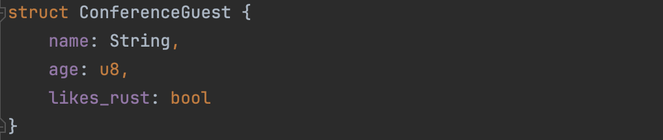
Creating a conference app

Slide 3
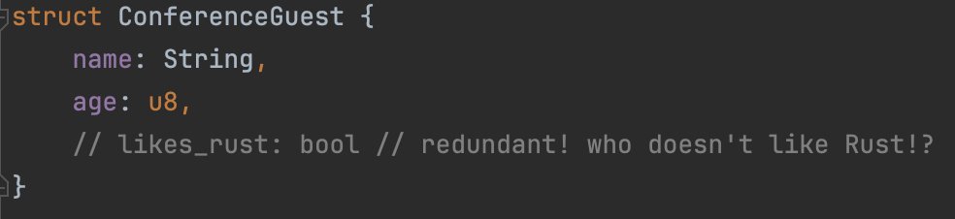
Creating a conference app

Slide 4
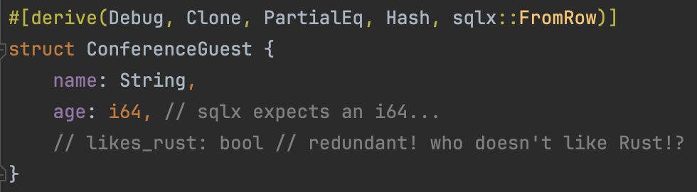
Creating a conference app

Slide 5
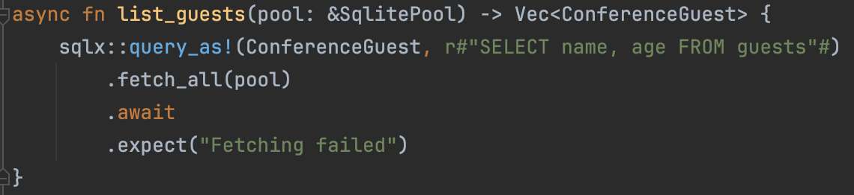
Creating a conference app

Slide 6
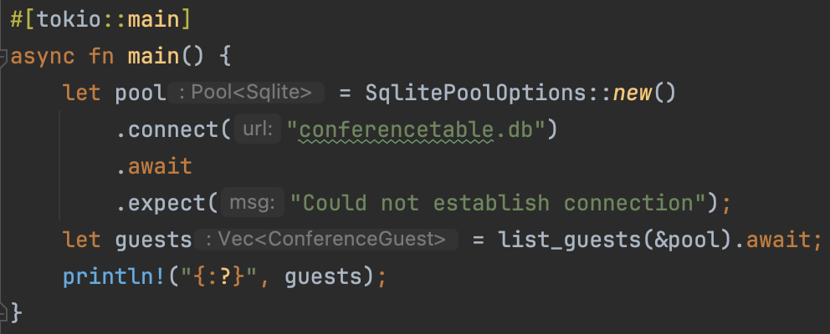
Creating a conference app

Slide 7
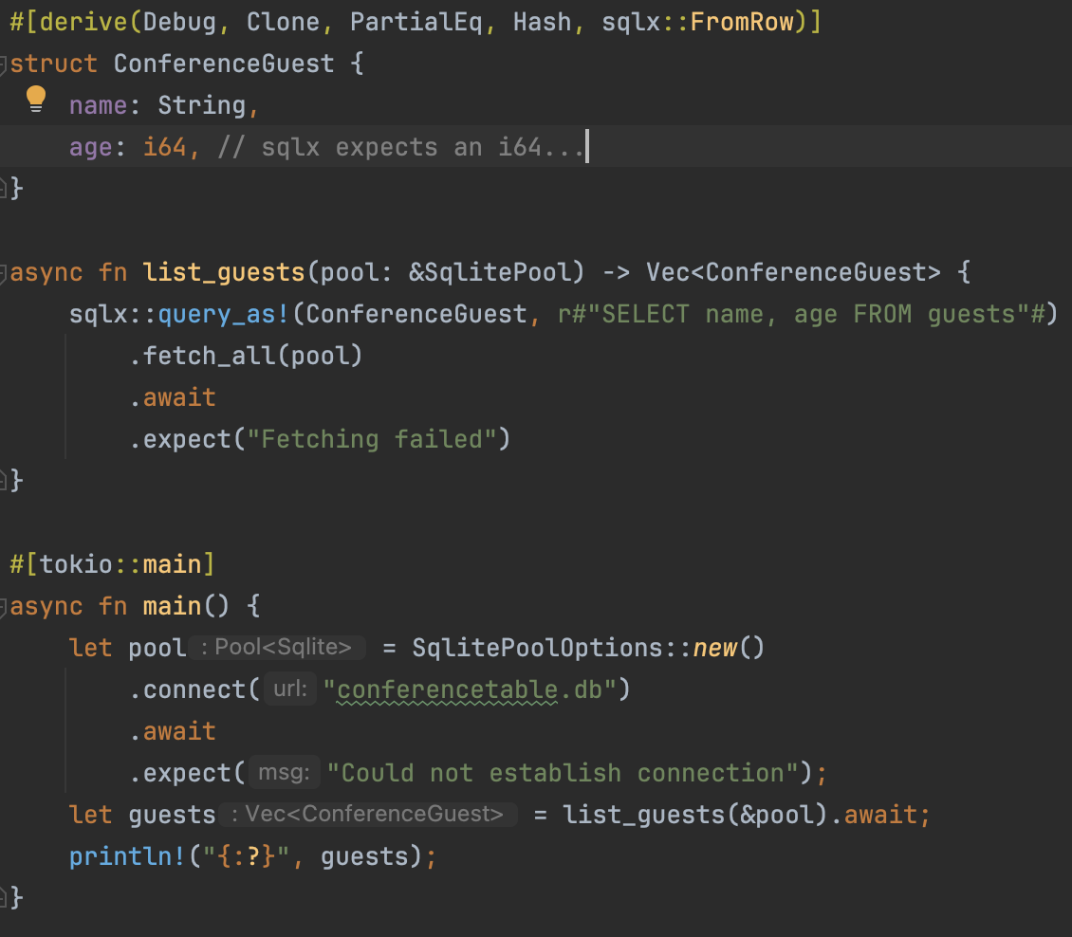

Slide 8
derive macro
function-like macro (behind a declarative)
attribute macro
declarative macro

Slide 9
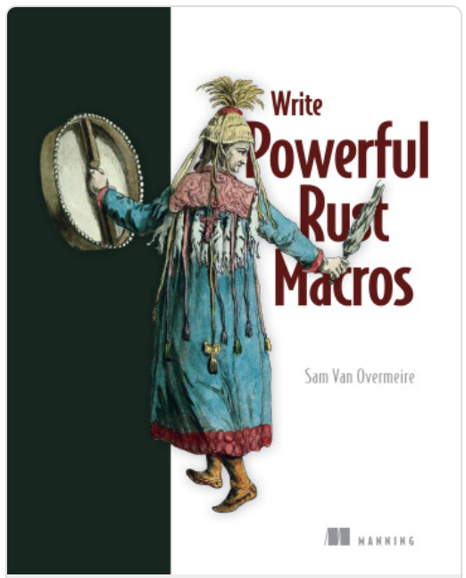

Bio
Sam Van Overmeire
Belgian
Historian, archaeologist
‘Cloud Consultant’ (@branch)
Likes Rust…
Wrote a book on macros

Slide 10
Metaprogramming in Rust
Macros are the main form of metaprogramming in Rust
Writing code that generates more code
‘Expanded’ at compile time
Why?
Avoiding boilerplate
Doing things you can’t normally do in Rust (variadic functions)

Slide 11
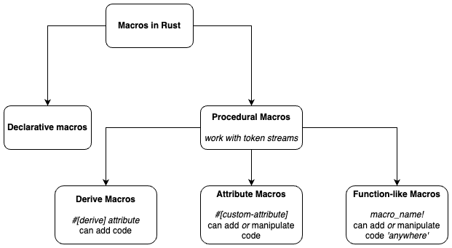
Macros in Rust

Slide 12
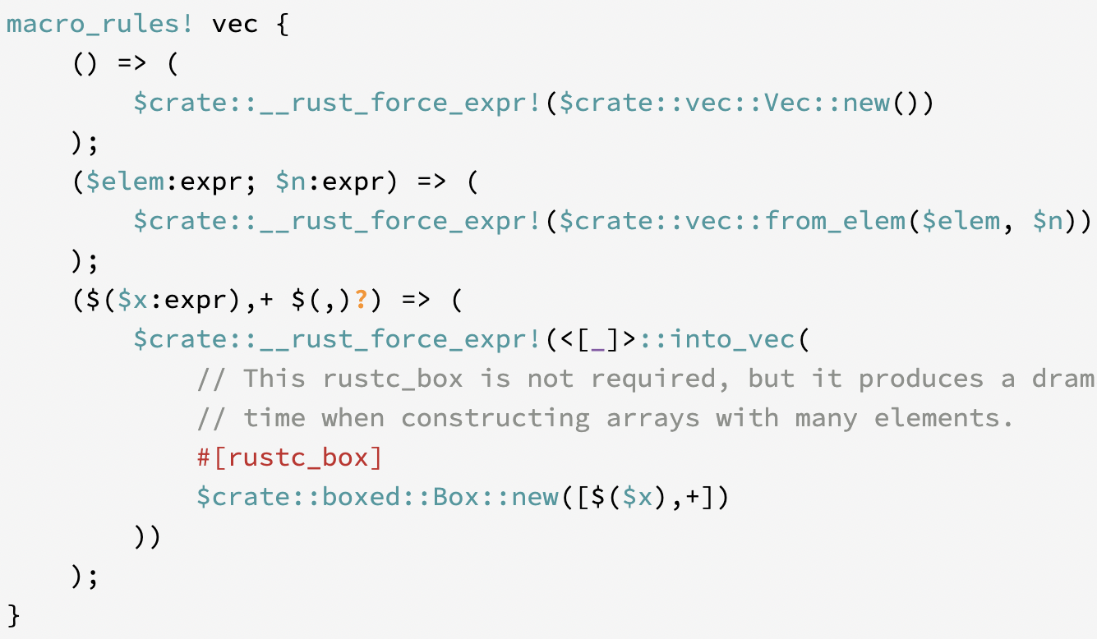
Declarative macros (vec!)

Slide 13
Macros in Rust

Slide 14
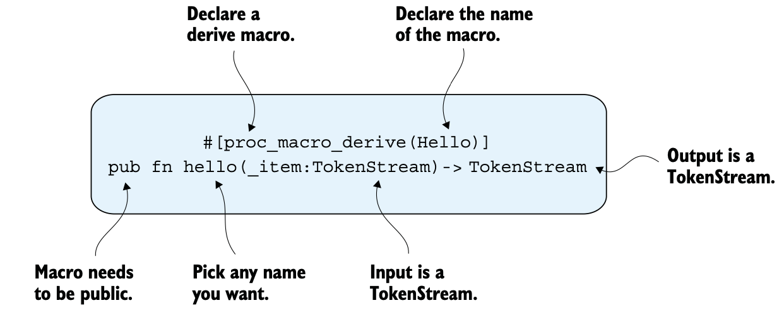
Derive macros
#[derive(...)], e.g. #[derive(Clone)]
Use them on structs, enums (and unions)
Will add code (cannot modify it)

Slide 15
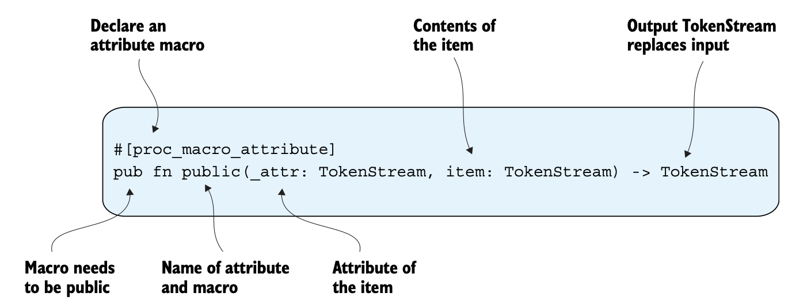
Attribute macros
#[name-of-macro] (with the below example: `#[public]`)
Use them on structs, enums (and unions), but also on functions!
Will replace the input tokens => can modify existing code
Additional tokenstream for attributes

Slide 16
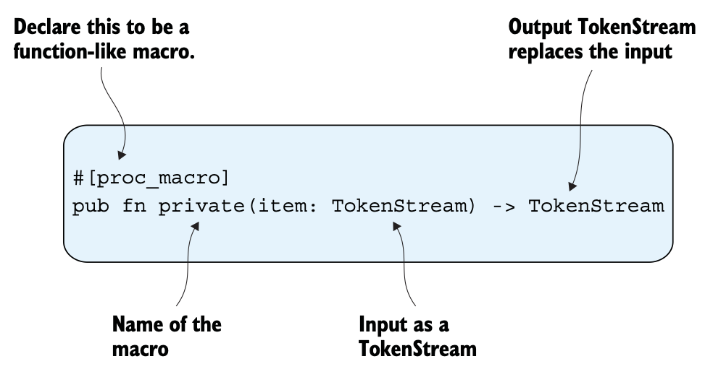
Function-like macros
name! (e.g. private!)
Can be used throughout your code base
Will replace the input tokens
Useful when the input is not valid Rust (e.g., DSL)

Slide 17
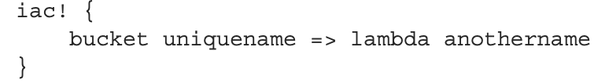
Function-like macros: DSL

Slide 18
Demo
Writing a derive macro
‘SQS helper’
DeriveInput
syn, quote
cargo expand

Slide 19
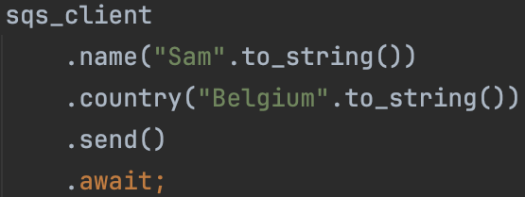
When to write macros? Which kind?
As little as possible
When you can’t elegantly solve problems (like boilerplate) with normal Rust
SQS helper?
SQS helper with builder (screenshot)?
Start simple
Declarative
Derive
SQS helper?
Attribute
Function-like
(And the same advice also kinda applies for using macros)

Slide 20
End
Thanks for listening!
Any questions (now or later)?

